Slide 1
Predicting Daily Demand within the SPP Footprint
A Proposal by James Lemley

Slide 2
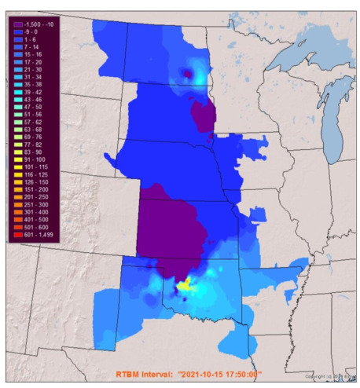
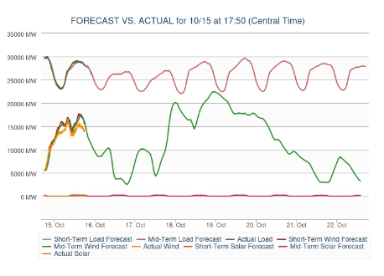
Southwest Power Pool, Inc. - Map and Forecast Graph
Images retrieved 2021-10-15 https://www.spp.org

Slide 3
Project Goal:
Explain Daily Variation in Total Electrical Demand
Independent variables will include:
Daily min/max temperatures in several locations
Major/Minor Holidays - people use less electricity on holidays
Day of week - Sunday is the least; Thursday is the most
Economic growth over time - linear? Polynomial?
Anything else I can think of. Near Christmas maybe.
Pandemic if 2020; will limit project to the before times

Slide 4
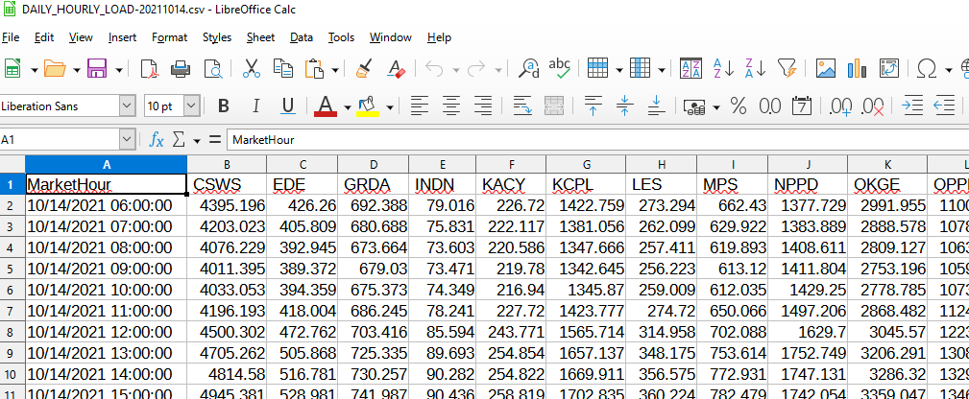
Target Data ftp://pubftp.spp.org/Operational_Data/HourlyLoad/

Slide 5
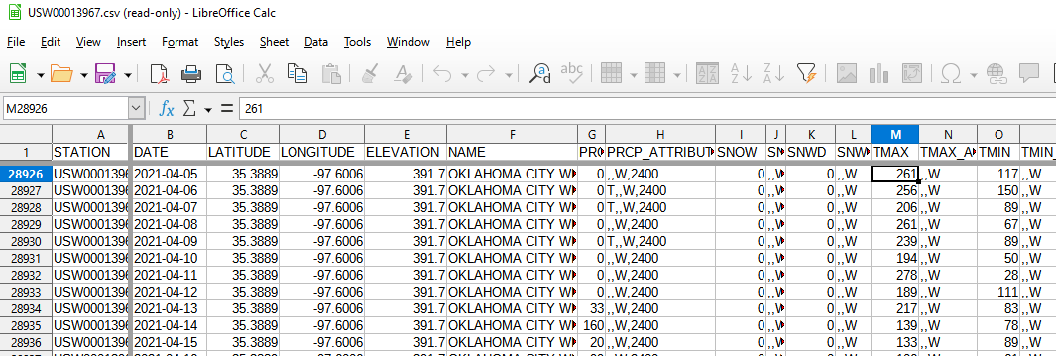
Weather Data https://www.ncei.noaa.gov/data/global-historical-climatology-network-daily/access/

Slide 6
This Project: Do It Better!
Old Analysis on 2015-2017 Data
POSIX, SQL and Excel
Correlation only - no predictions
No feature normalization
Multiple regression only
At the daily level only
Econometrics Ph.D. said “Don’t show this to anyone”
New Analysis on Same Data
Python, Pandas and Scikit-Learn
Predictions, with accuracy and fitness measures!
Dimensionality reduction with PCA!
Feature normalization!
Use all the methods!
Want “show this to everyone!”
Stretch Goal:
Can I use RNN to predict hourly?

Slide 7
end

